Slide 1
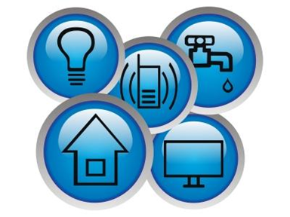
Utility
Tracker
Miles Crabbe, Ethan Downey, Chad Easter

Slide 2
Problem Definition
There is no unified utility outage/performance tracker
None are app based
All are in house programs and based on classical styles of gathering data, sensors, tests, etc.

Slide 3
Scope of System
All Major Utilities: Gas, Water, Power, Phone, Internet, etc.
All major providers of each utility
City wide to begin with, but with server based data and crowd sourcing, the service could grow to be very large
Ability to search for reports locally and on a large scale within the app

Slide 4
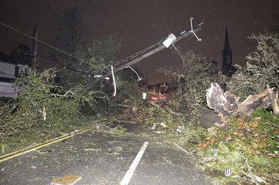
Problem Example
Normal Testing too limited
No knowledge of line condition beyond certain points in the network
Over allocation of resources to fix a relatively small problem
Required allocation of human resources to find side issues
Solution:
Customers report downed lines
Customers report damage to lines on personal property
Company can see extent of damage before sending any employee into the damaged area

Slide 5
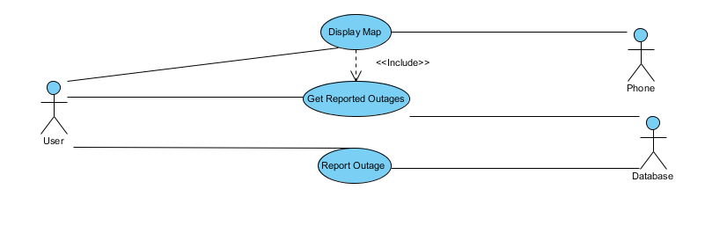
Basic User Use Case

Slide 6
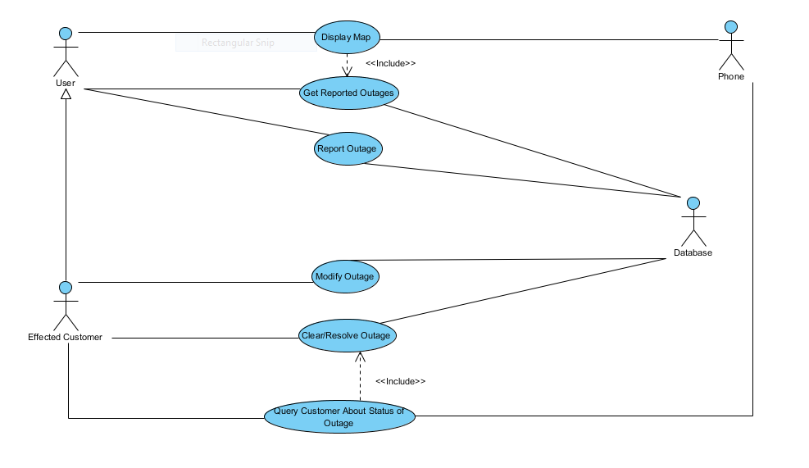
Affected User Use Case

Slide 7
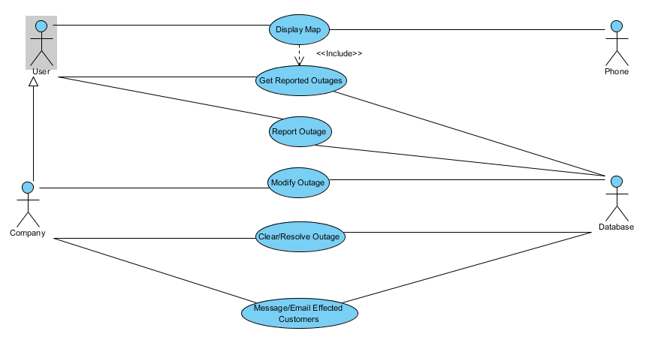
Company Use Case

Slide 8
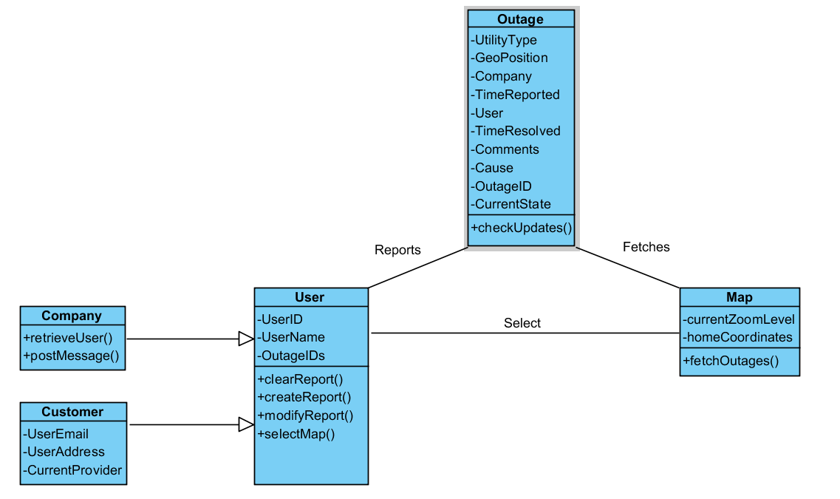
Class Diagram

Slide 9
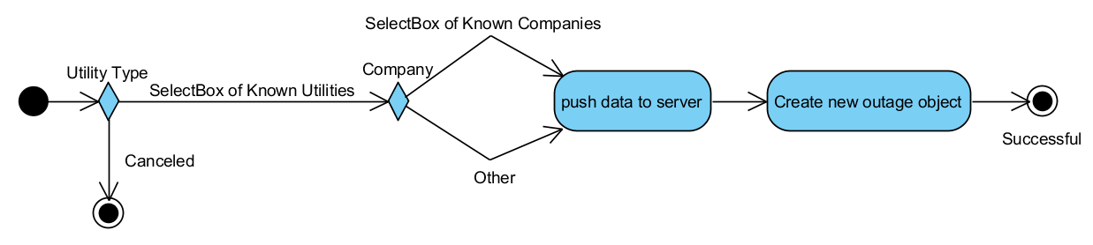
Report Outage Activity

Slide 10
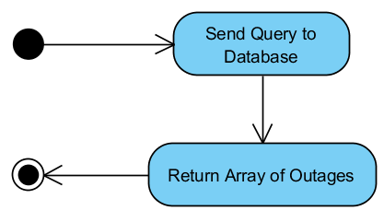
Get Outages Activiity

Slide 11
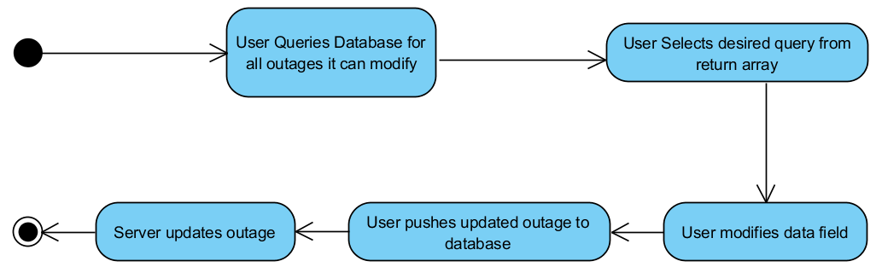
Modify Existing Report Activity

Slide 12
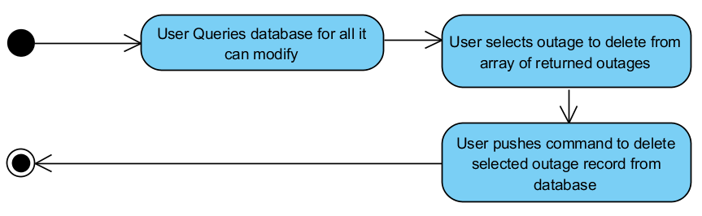
Delete Outage Report Activity

Slide 13
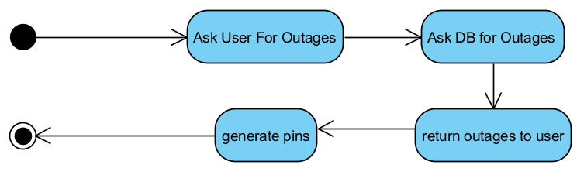
Generate Map Activity

Slide 14
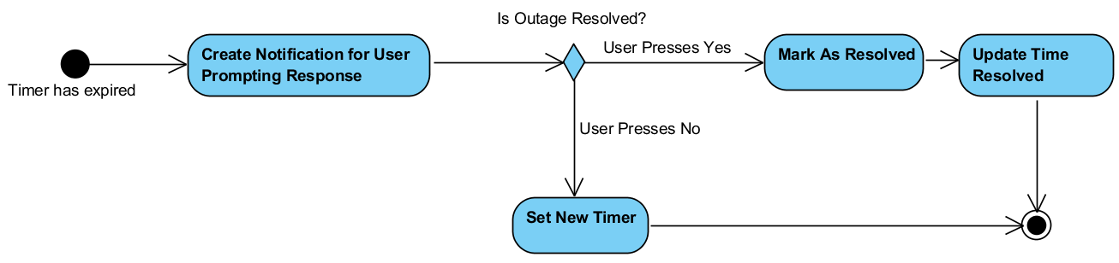
Query User for Update Activity

Slide 15
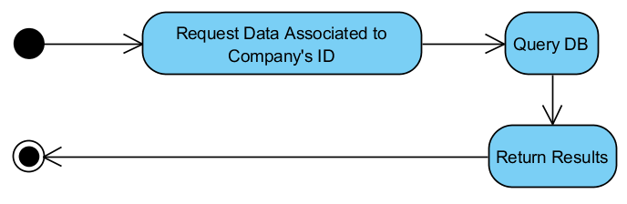
Retrieve Affectred Customers Activity

Slide 16
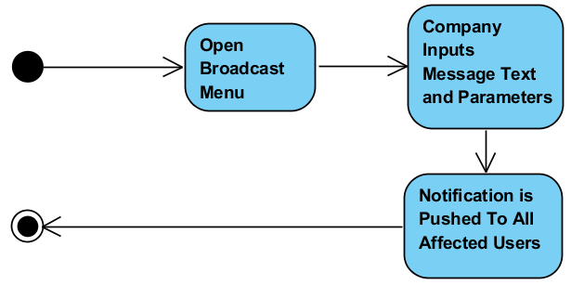
Message Affected Users Activity

Slide 17
Features
Required:
Outage Reports
Outage Map
Company to User messaging
Sorting of Reports by type/company
Outage History
System preventing erroneous reports
Alerts
Possible:
Company Reports
Company Leaderboards
Comments about outage
Analytics about outages in area
Company Analytics
Time Permitting:
Monetization
Pro features
Company Specific forms of app
Support Ticket system

Slide 18
Risks
Lack of User involvement = little data
Abusing app by reporting false outages
“Fixing” company ratings by abusing outage reporting
Companies receiving skewed ratings when customers fail to mark an outage “resolved”
Excessive amounts of data in storage
Privacy and safety concerns from knowing who does not have utility service.

